Slide 1
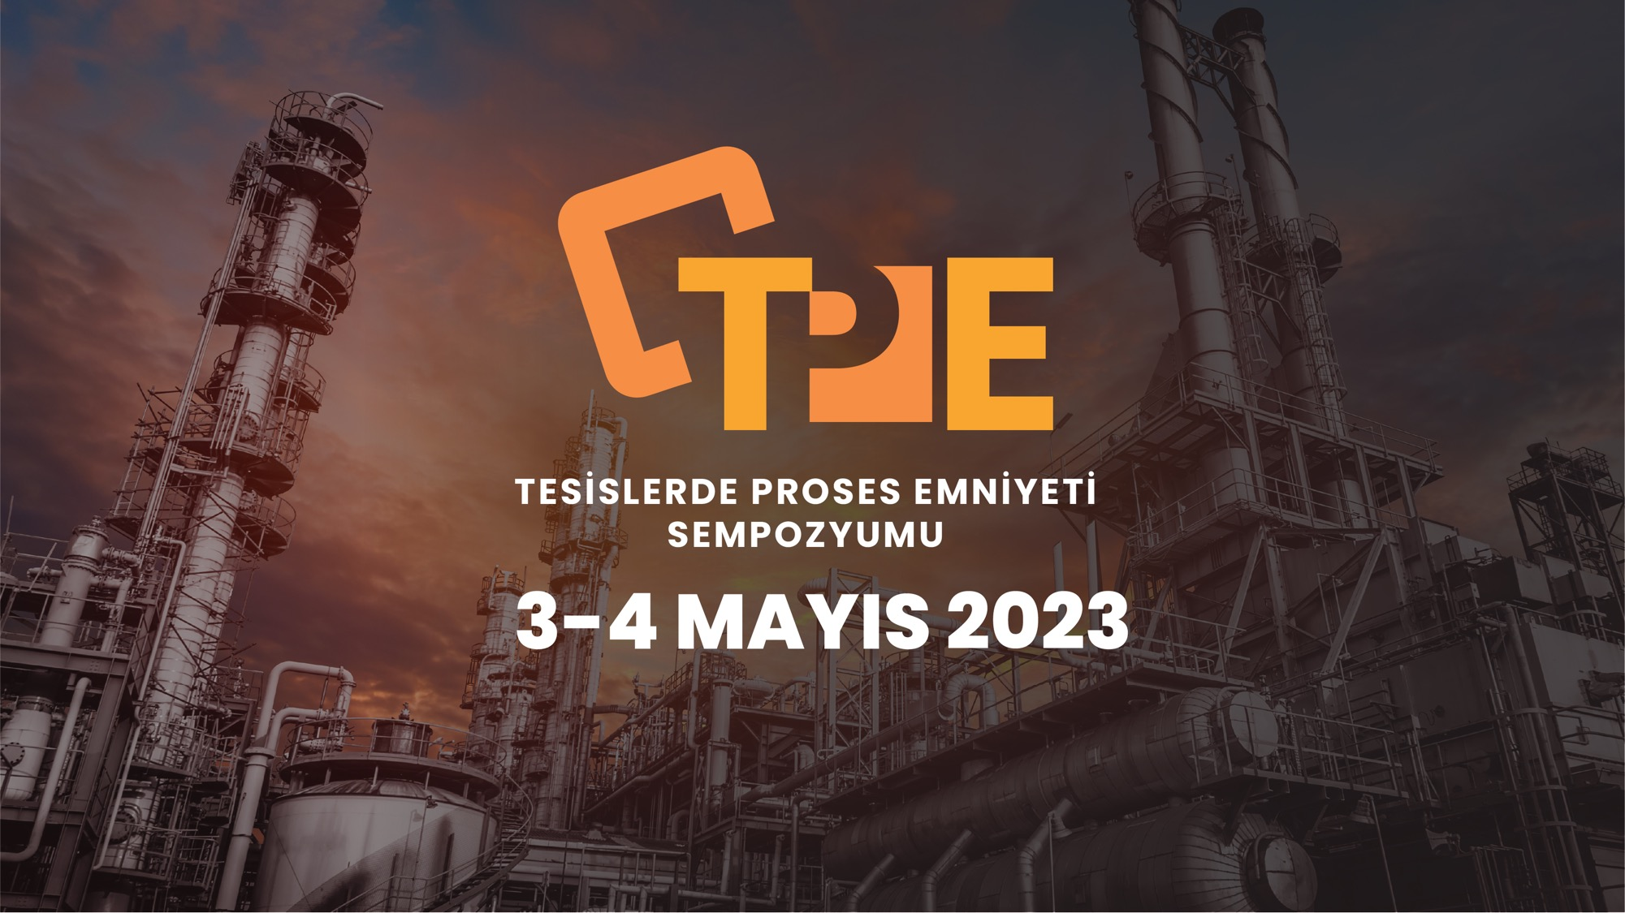


Slide 2


ICSFusion
Endüstriyel Proses Güvenliği ve Siber Güvenlik

Slide 3



Electrical & Electronics Engineer
10+ Cyber Security Experience
7+ ICS/SCADA Cyber Security
Volunteer @ BootCamp & EKSKonferans
CCI Turkey Co-Coordinator
Can Demirel (@secandit)
ICSFusion Co-Founder

Slide 4

Team Experience
Oil & Gas
Tranmission & Distribution
Power Plants
Mining
Pipelines
Water
Manufacturing

Slide 5
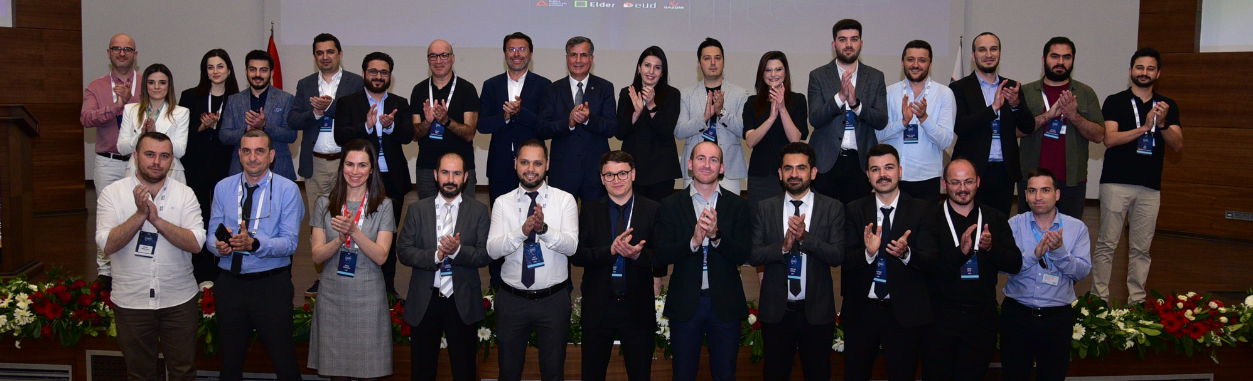
A team at national scale!
We led First ICS Security Focused National Cyber Exercise
with 200+ Asset Owners

Slide 7
Bu sayfayı çoğaltarak iç sayfalarınızda istediğiniz düzende kullanabilirsiniz.

Slide 8
Unexpected downtime costs 250.000k USD and up to %82 industrial companies faces unexpected downtime.

Slide 9
“Time
is an illisuion”
A. Einstein

Slide 10
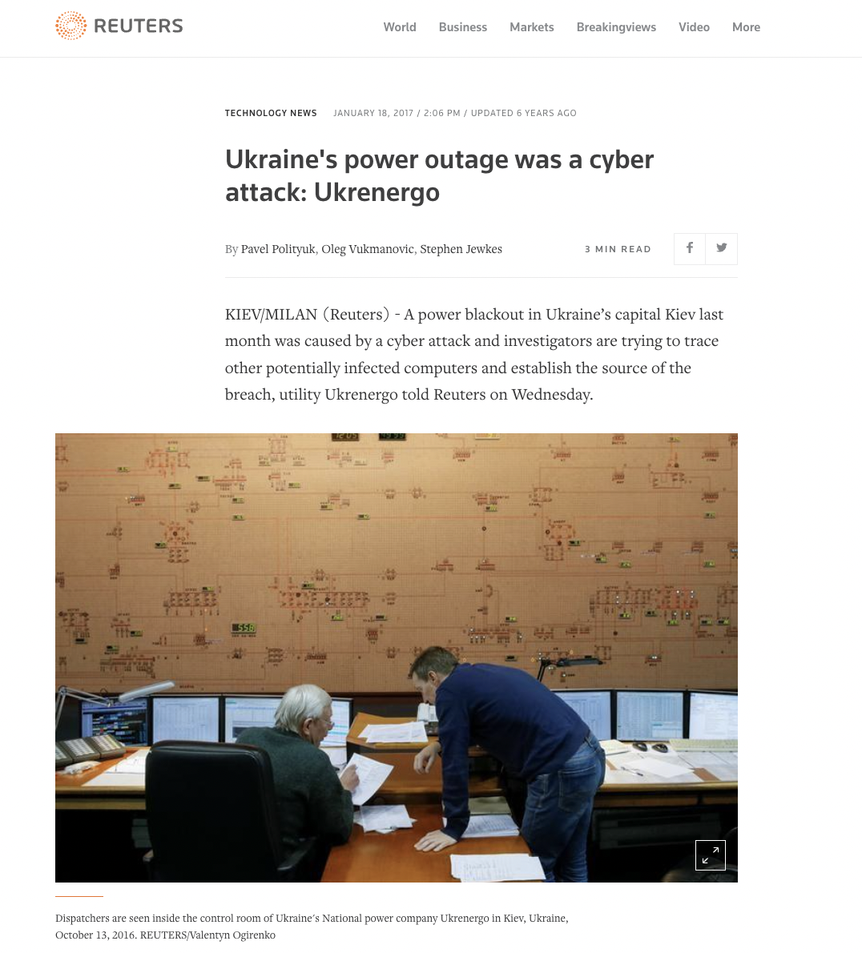
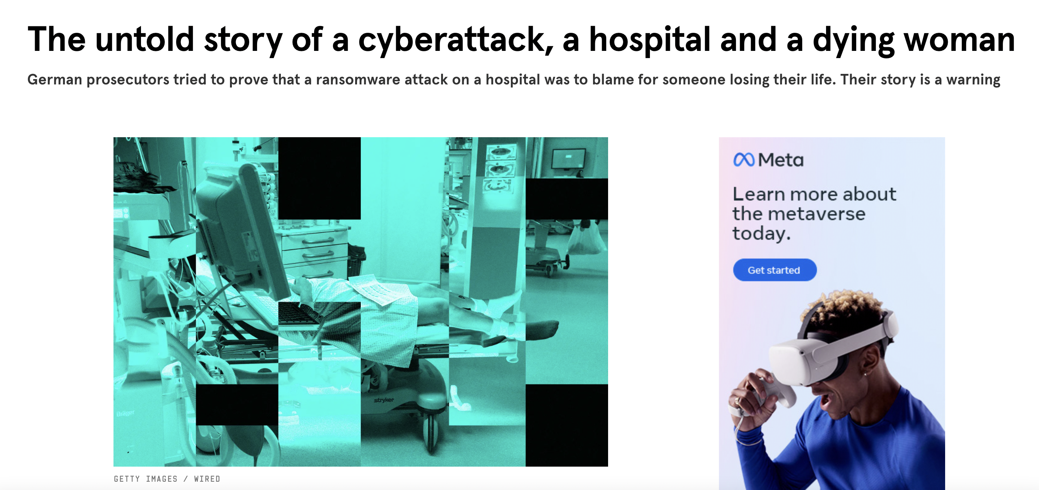

Slide 11
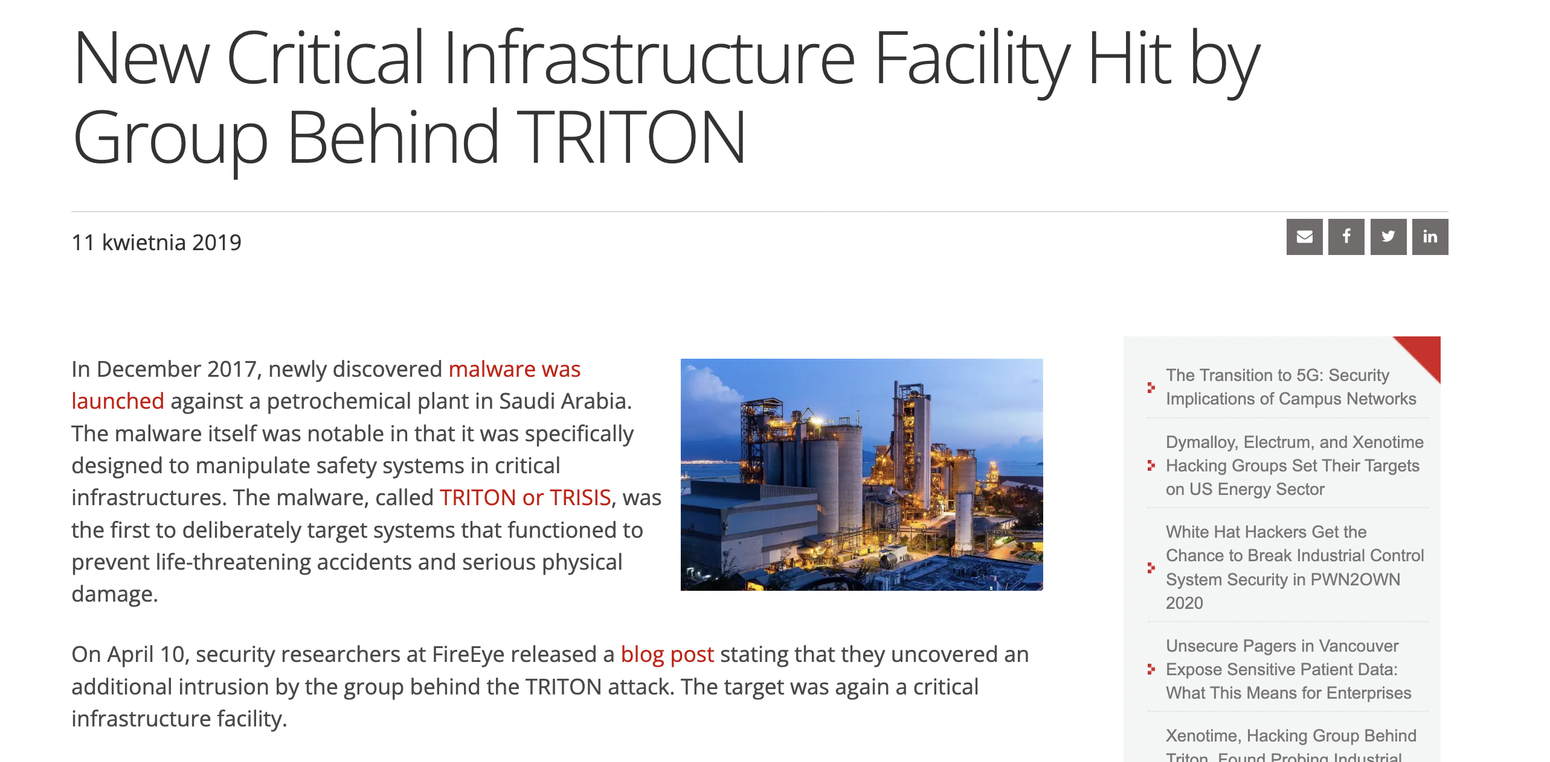

Slide 12
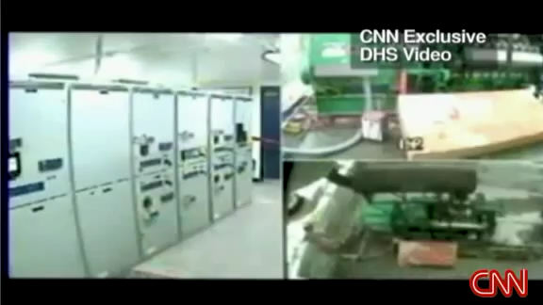

Slide 13
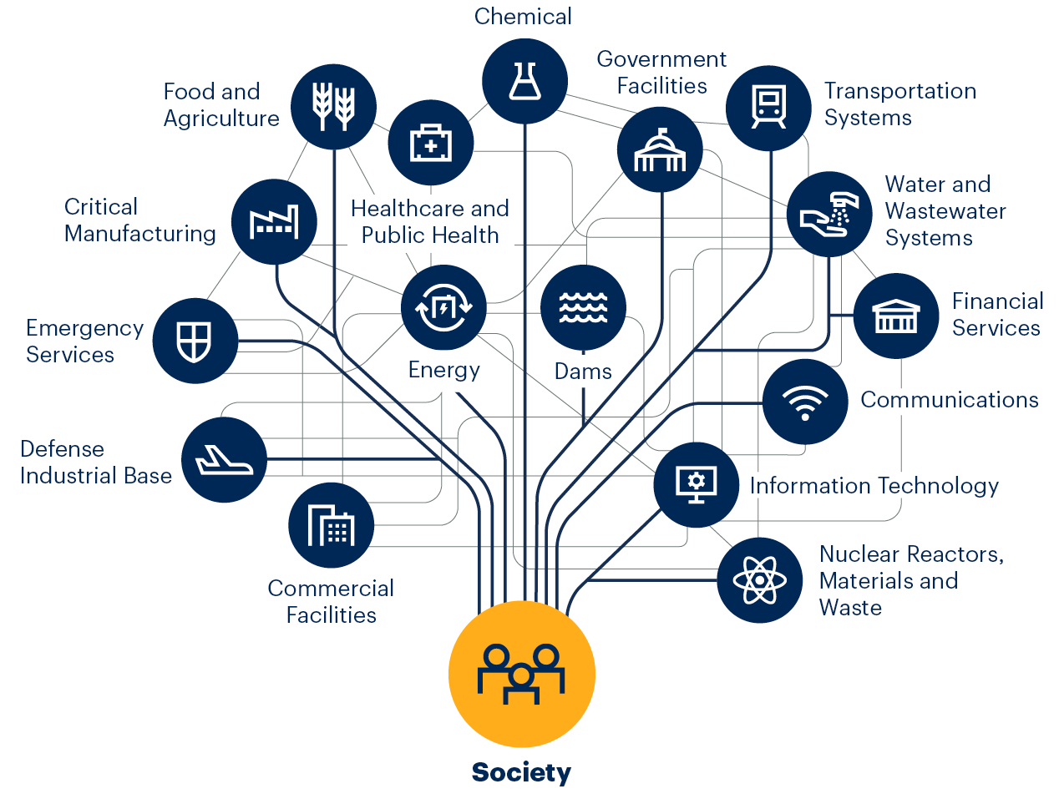
Understanding the Lanscape
By 2024, 80% of critical infrastructure organizations will abandon their existing siloed security solutions providers in order to bridge cyber-physical and IT risks by adopting hyper-converged solutions.*
Through 2025, 30% of critical infrastructure organizations will experience a security breach that will result in the halting of an operations- or mission-critical cyber-physical system.*
Through 2026, less than 30% of U.S. critical infrastructure owners and operators will meet newly mandated government security requirements for cyber-physical systems.*
Industrial Control Systems Security Market Size To Reach USD 34.64 BN In 2030 **
*Predicts 2022: Cyber-Physical Systems Security — Critical Infrastructure in Focus Published 17 November 2021 - ID G00757423
**https://www.prnewswire.com/news-releases/industrial-control-systems-security-market-size-to-reach-usd-34-64-bn-in-2030-due-to-stringent-government-regulations-on-critical-infrastructure-protection-to-increase-adoption-of-ics-security-solutions-says-reports-and-data-301534475.html

Slide 14
Process-wise Cybersecurity
Compressor & Valve stations
Metering
SIS/ESD
Distilling
Utilities
Aromatics
Cracking
Core Processes
Fire System
Flare & atmospheric ventilation
Reforming
Blending
HVAC
Treating
Refinery Processes
Power Generation
Power Operations
Power Distribution
Truck
Load Shedding
Train
Trade Operations
Raw Water
Ship
Water/Waste-water Management
Biological Treatment
Pipeline
IT & Information Systems
Waste Management

Slide 15
We are running but we are still falling behind!
Speedy Digitalization
Lack of human & technology resources
Current market focus is anomaly and threat detection
Lack of prioritization
Increased attacks and attack surface
Regulation pressure

Slide 16
ICSFusion
Industrial Cybersecurity Visibility and Compliance Platform

Slide 17
ICSFusion Platform
Asset Management
Anomaly & Threat Detection
Vulnerability Identification & Management
Rapid & Continuous Assessment
Industrial Risk Scoring Prioritization
Continuous Compliance

Slide 18
How it works?
Actionable Data
Asset, Threat, Vulnerability, Risk
Data Collection

Slide 19
Bu sayfayı çoğaltarak iç sayfalarınızda istediğiniz düzende kullanabilirsiniz.

Slide 20


